Slide 1
Helinks STS
Top Down
IEC 61850 Engineering

Slide 2

Joerg Reuter,
jr@helinks.com,
+41 76 340 8089
HELINKS LLC,
Zug Switzerland
HELINKS provides IED vendor independent IEC 61850 engineering tools

Slide 3

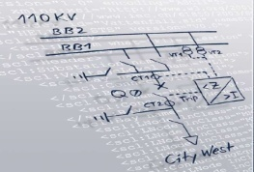
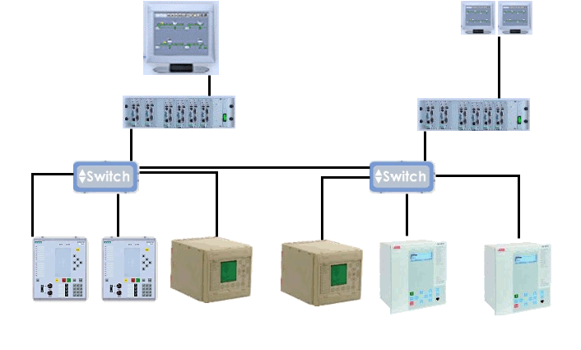
Scope of Helinks STS
HELINKS STS
System
Specification
Tool
SCL
IED
PDIS
IED
Configuration Tool
System
IntegrationTool

Slide 4
IEC 61850 Top Down Process
HELINKS STS
System Specification
Tool
Doc
ICD
System Configuration
Tool
SCD
IED
Configuration
Tool
SSD
SCD
CID
Doc
IID

Slide 5
Classical Project Engineering Process
Informal Specification
Informal Design
Bottom Up Engineering
IED
Excel,
Visio
&
MS Word
Excel
&
VBA
PDIS
IED
IED
Configuration Tool
PDIS
CID
IED
Configuration Tool
CID
IED
CID
CID
PDIS
IED
Configuration Tool
IED
CID
PDIS
IED
Configuration Tool
Design
Standards
CID
IED
PDIS
IED
Configuration Tool

Slide 6
Engineering Efficiency
Specification
Design
System Engineering
HELINKS STS
IEC 61850 SCL Data Flow
Engineering
Libraries
ICD
ICD
System Specification
Tool
System Configuration
Tool
SCD
IED
Configuration
Tool
Specification
Libraries
Doc
CID
Fully automated
communication configuration
IID
CID
Specification is created just by drawing the Single Line !
Drop IED’s into the project. STS automatically allocates Logical Nodes and Signals.
Communication configuration is fully automated.
Notes:
In times of Edition 1 of the standard engineers were generally forced to use the « CID centered process » because of tool interoperability problems between the available SCTs and ICTs. That is why we called this approach « De Facto ».
Edition 2 and the IOPs of 2013 and 2015 helped to improve this shortcome. Today we find more and more projects following the SCT based approach. We will not go into the details of both processes. This is out of the scope of this paper.
Let us come back to the different approaches for specification and design and start with the « Informal Design »

Slide 7
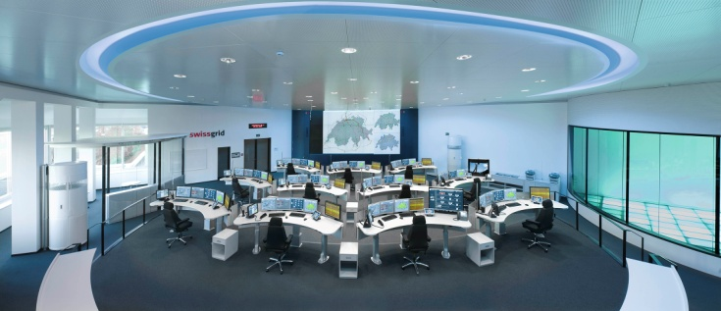

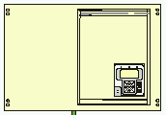
Example Application:Reverse Blocking
Control LV
Transformer Protection Main 1
Reverse blocking
Trigger Breaker Failure
Feeder Control
Feeder Protection
Feeder Control
Feeder Protection

Slide 8
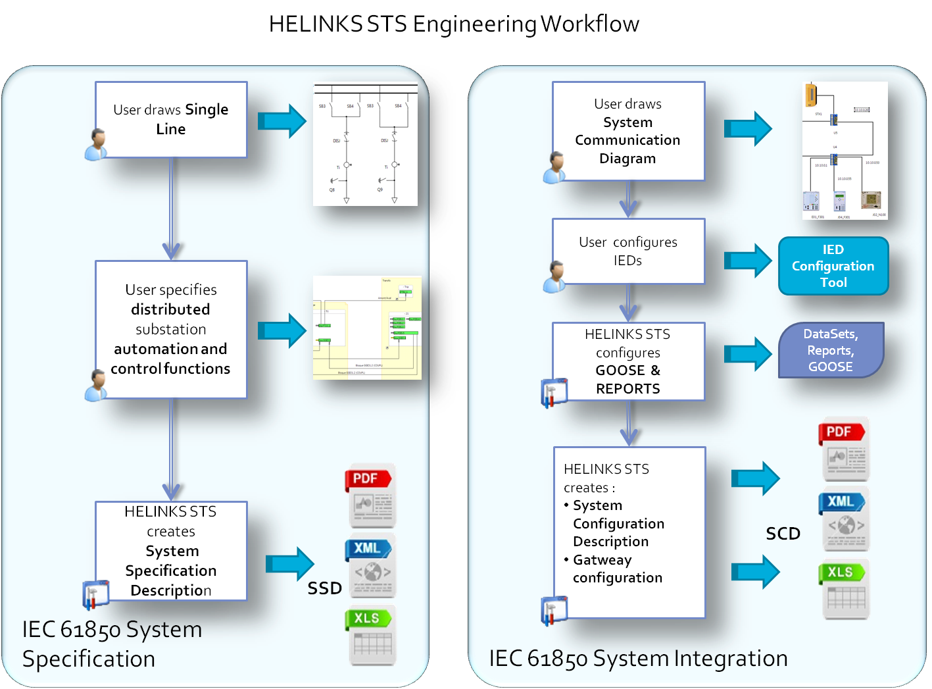

Slide 9
How can we support you?
IEC61850 basics training and engineering training
HELINKS STS tool training
Project participation and coaching (pilot projects and production)
Custom developments ( Utility Packages)
Thank you for joining
at this webcast.

